Slide 1
Chapter 6 – Point estimation

Slide 2
Outline
General concepts
Methods of Point Estimation

Slide 3
Population
Sample
Inference
Parameters
Statistics

Slide 4
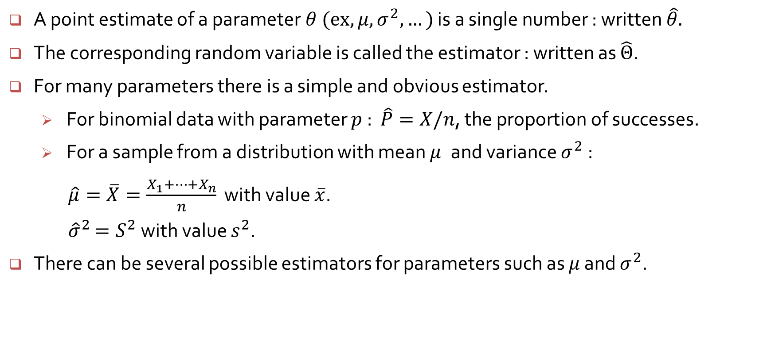
General concepts of point estimation
A point estimate of a parameter$θ (ex, μ, σ^{2},…)$ is a single number : written $\hat{θ}.$
The corresponding random variable is called the estimator : written as $\hat{Θ}$.
For many parameters there is a simple and obvious estimator.
For binomial data with parameter $p$ : $\hat{P}=X/n$, the proportion of successes.
For a sample from a distribution with mean $μ$and variance $σ^{2}$:
$\hat{μ}=\overline{X}=\frac{X_{1}+⋯+X_{n}}{n}$ with value $\overline{x}$.
${\hat{σ}}^{2}$ $=S^{2}$ with value $s^{2}$.
There can be several possible estimators for parameters such as $μ$ and $σ^{2}$.

Slide 5
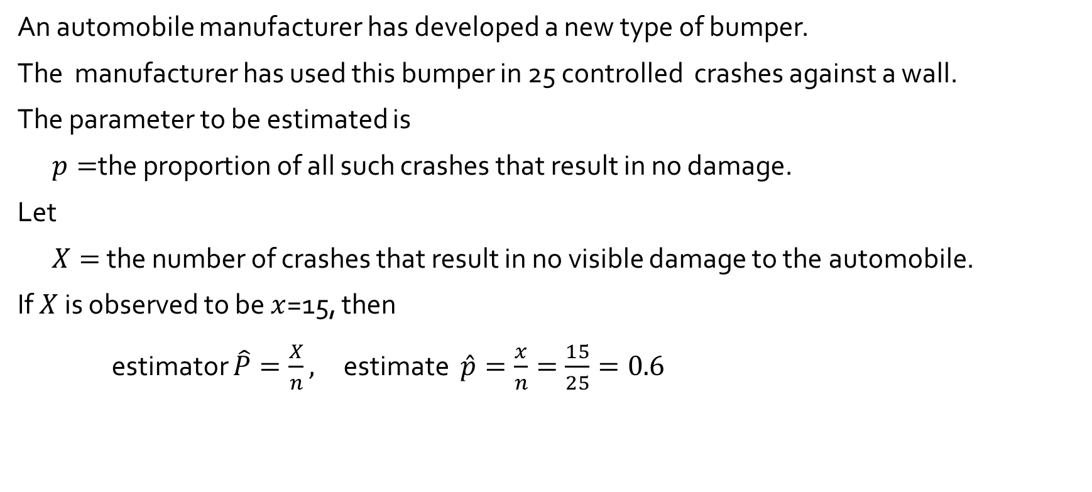
Example 6.1
An automobile manufacturer has developed a new type of bumper.
The manufacturer has used this bumper in 25 controlled crashes against a wall.
The parameter to be estimated is
$p=$the proportion of all such crashes that result in no damage.
Let
$X=$ the number of crashes that result in no visible damage to the automobile.
If $X$ is observed to be $x$=15, then
estimator $\hat{P}=\frac{X}{n},$ estimate $\hat{p}=\frac{x}{n}=\frac{15}{25}=0.6$

Slide 6
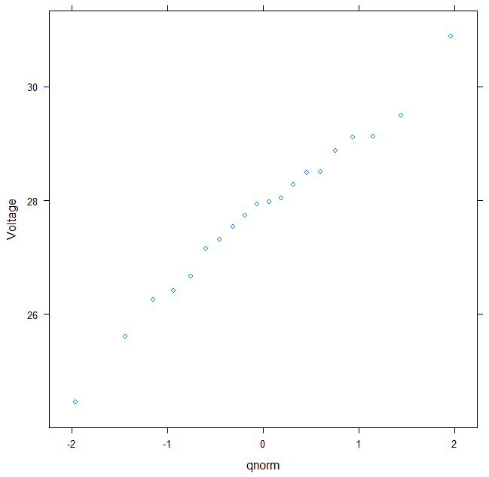
Example 6.2 : Dielectric breakdown voltage for epoxy resin
A normal probability plot shows that the data closely follow a normal shape
> str(xmp06.02)
> qqmath(~Voltage, xmp06.02)
> sort(xmp06.02$Voltage)
[1] 24.46 25.61 26.25 26.42 26.66 27.15 27.31 27.54 27.74 27.94 27.98 28.04
[13] 28.28 28.49 28.50 28.87 29.11 29.13 29.50 30.88

Slide 7
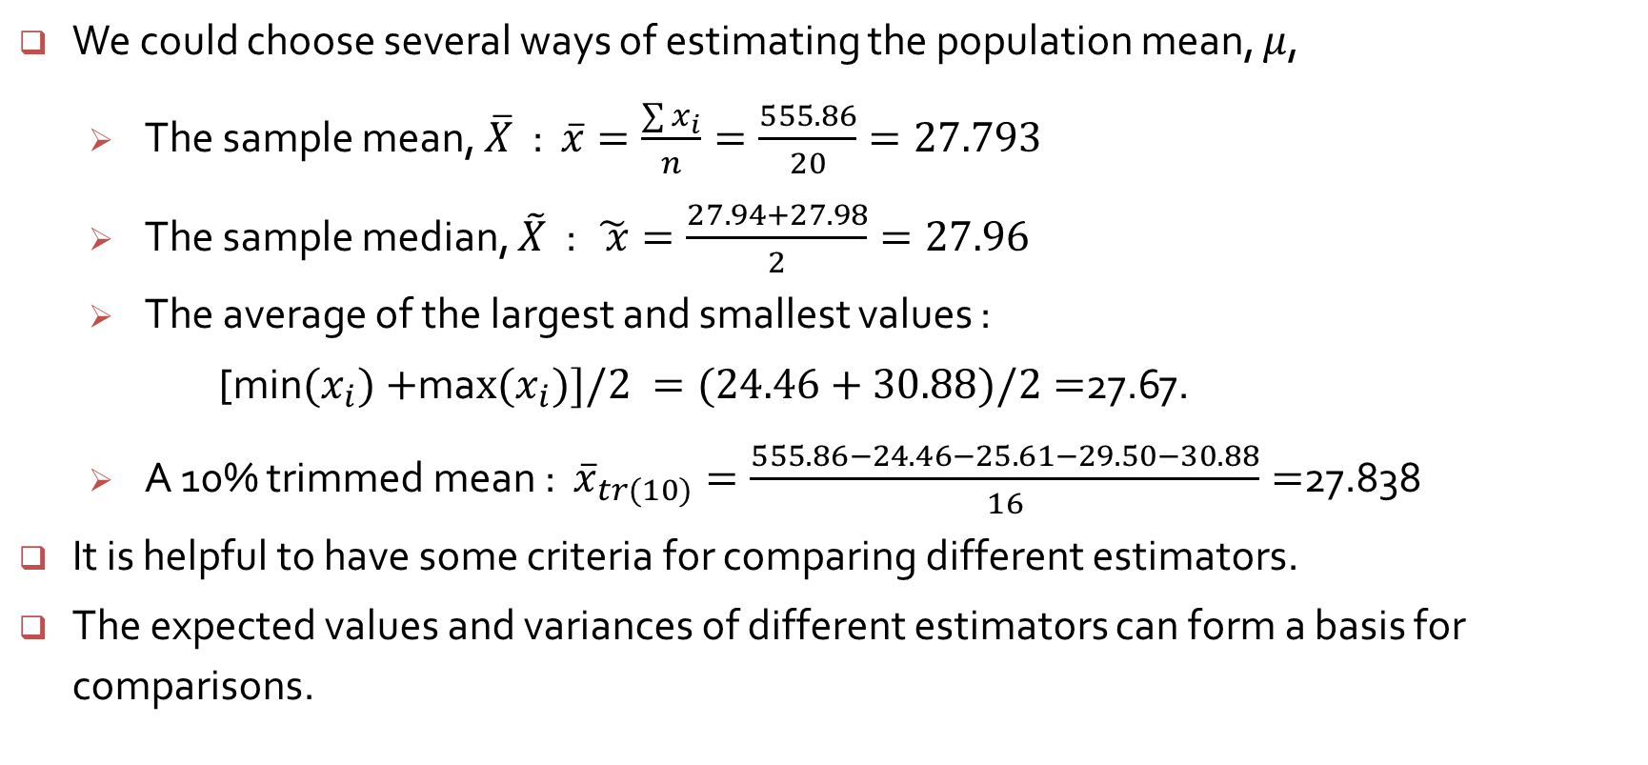
Example 6.2 (cont’d)
We could choose several ways of estimating the population mean, $μ$,
The sample mean, $\overline{X}$ : $\overline{x}=\frac{\sum{x_{i}}}{n}=\frac{555.86}{20}=27.793$
The sample median, $\tilde{X}$ : $\tilde{ x}=\frac{27.94+27.98}{2}=27.96$
The average of the largest and smallest values :
[min${(x}_{i})+$ma$x(x_{i})]/2 =(24.46+30.88)/2=$27.67.
A 10% trimmed mean : ${\overline{x}}_{tr(10)}=\frac{555.86−24.46−25.61−29.50−30.88}{16}=$27.838
It is helpful to have some criteria for comparing different estimators.
The expected values and variances of different estimators can form a basis for comparisons.

Slide 8



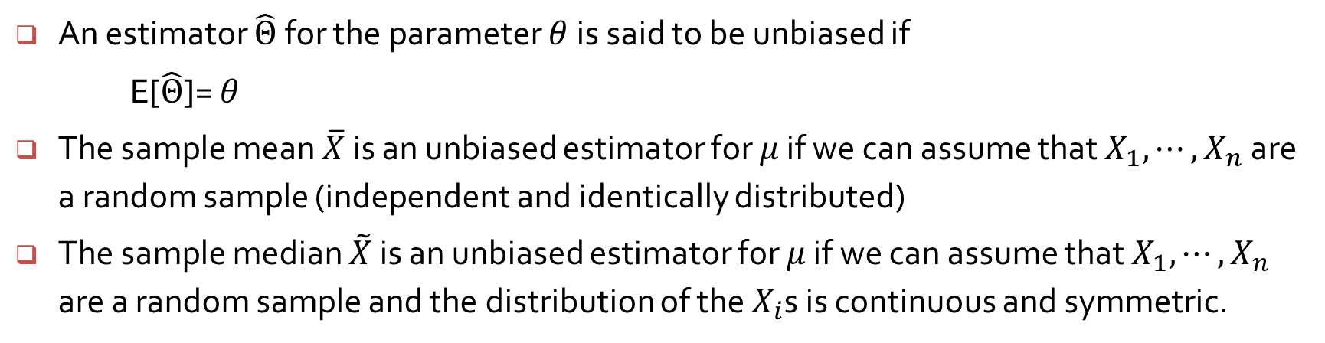





Unbiasedness
An estimator $\hat{Θ}$for the parameter $θ$is said to be unbiased if
E[$\hat{Θ}$]= $θ$
The sample mean $\overline{X}$ is an unbiased estimator for $μ$ if we can assume that $X_{1},⋯,X_{n}$ are a random sample (independent and identically distributed)
The sample median $\tilde{X}$ is an unbiased estimator for $μ$ if we can assume that $X_{1},⋯,X_{n}$ are a random sample and the distribution of the $X_{i}$s is continuous and symmetric.
$$n_{1}$$
$${\overline{x}}_{1}$$
$$n_{2}$$
$${\overline{x}}_{2}$$
$$\frac{{\overline{x}}_{1}+{\overline{x}}_{2}⋯+{\overline{x}}_{k}}{k}≈μ$$
$$⋮$$
$$n_{k}$$
$${\overline{x}}_{k}$$

Slide 9
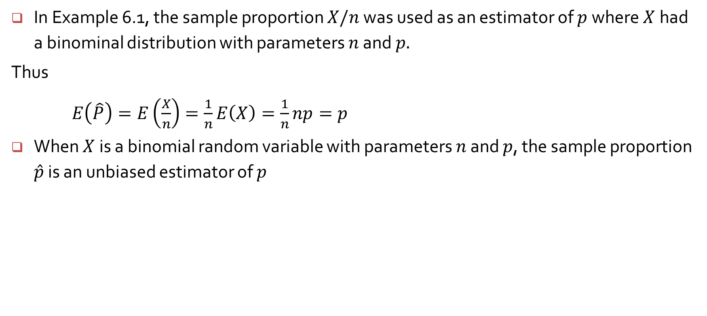
In Example 6.1, the sample proportion $X/n$ was used as an estimator of $p$where $X$had a binominal distribution with parameters $n$ and $p.$
Thus
$E\left(\hat{P}\right)=E\left(\frac{X}{n}\right)=\frac{1}{n}E\left(X\right)=\frac{1}{n}np=p$
When $X$is a binomial random variable with parameters $n$ and $p$, the sample proportion $\hat{p}$ is an unbiased estimator of $p$

Slide 10
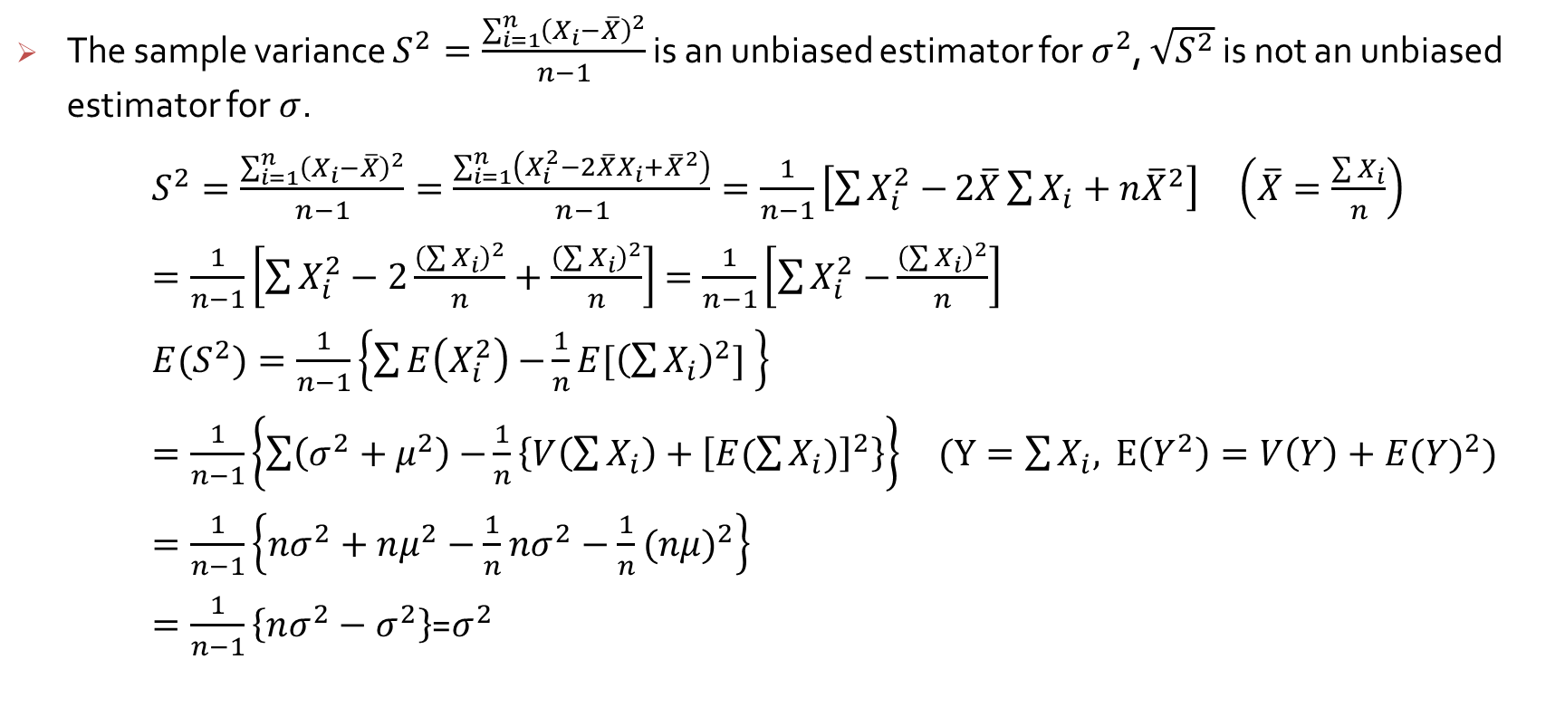
Unbiasedness
The sample variance $S^{2}=\frac{\sum_{i=1}^{n}{{\left(X_{i}−\overline{X}\right)}^{2}}}{n−1}$ is an unbiased estimator for $σ^{2}$, $\sqrt{S^{2}}$ is not an unbiased estimator for $σ$.
$S^{2}=\frac{\sum_{i=1}^{n}{{\left(X_{i}−\overline{X}\right)}^{2}}}{n−1}=\frac{\sum_{i=1}^{n}{\left(X_{i}^{2}−2\overline{X}X_{i}+{\overline{X}}^{2}\right)}}{n−1}=\frac{1}{n−1}\left[\sum{X_{i}^{2}−}2\overline{X}\sum{X_{i}}+n{\overline{X}}^{2}\right]$ $\left(\overline{X}=\frac{\sum{X_{i}}}{n}\right)$
$=\frac{1}{n−1}\left[\sum{X_{i}^{2}−2\frac{{\left(\sum{X_{i}}\right)}^{2}}{n}+\frac{{\left(\sum{X_{i}}\right)}^{2}}{n}}\right]$ $=\frac{1}{n−1}\left[\sum{X_{i}^{2}−}\frac{{\left(\sum{X_{i}}\right)}^{2}}{n}\right]$
$E{(S}^{2})=\frac{1}{n−1}\left\{\sum{E\left(X_{i}^{2}\right)−}\frac{1}{n}E[{\left(\sum{X_{i}}\right)}^{2}] \right\}$
$=\frac{1}{n−1}\left\{\sum{\left(σ^{2}+μ^{2}\right)−}\frac{1}{n}\left\{V\left(\sum{X_{i}}\right)+{\left[E(\sum{X_{i}})\right]}^{2}\right\}\right\} (Y=\sum{X_{i},}$ $E\left(Y^{2}\right)=V\left(Y\right)+{E(Y)}^{2})$
$=\frac{1}{n−1}\left\{nσ^{2}+nμ^{2}−\frac{1}{n}nσ^{2}−\frac{1}{n}{(nμ)}^{2}\right\}$
$=\frac{1}{n−1}\left\{nσ^{2}−σ^{2}\right\}$=$σ^{2}$

